Slide 1
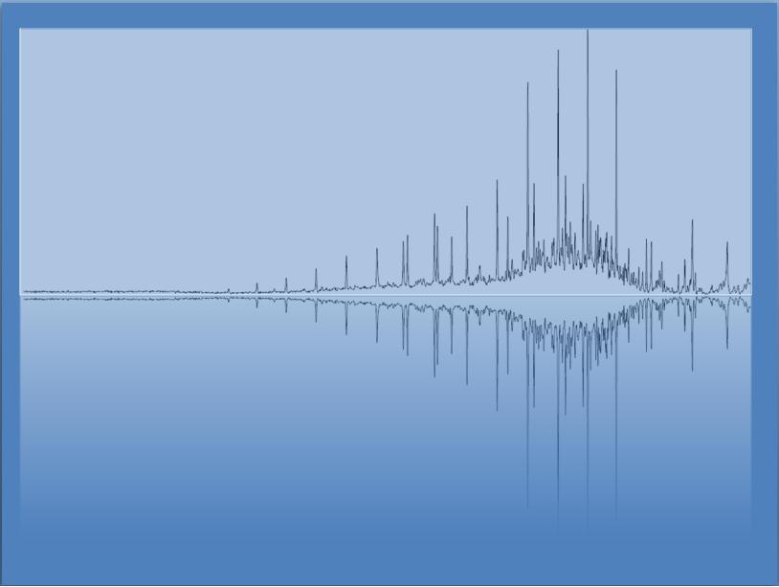
Oxidation and Reduction (Redox)
Chem 3A- Yates

Slide 2
Outline
What is Redox?
Determining Oxidation States
Balancing Redox Reactions
The Activity Series (Predicting if a reaction will happen.)

Slide 3
Oxidation and Reduction
Reactions where electrons are transferred from one atom to another are redox reactions.
Atoms that gain electrons are being reduced.
Atoms that lose electrons are being oxidized
Ger
Leo
2 Na(s) + Cl₂(g) → 2 Na⁺Cl–(s)
Na → Na⁺ + 1 e– (oxidation)
Cl₂ + 2 e– → 2 Cl– (reduction)

Slide 4
Oxidation and Reduction
2 Na(s) + Cl₂(g) → 2 Na⁺Cl–(s)
Oxidation
States
+4
+3
+2
+1
0
-1
-2
-3
-4
Reduced (Element)
Oxidized (Element)
Oxidizing (Reactant)
Agent
Reducing (Reactant)
Agent

Slide 5
Oxidation and Reduction
2 Na(s) + Cl₂(g) → 2 Na⁺Cl–(s)
Oxidation
States
+4
+3
+2
+1
0
-1
-2
-3
-4
Cl
Na
Reduced (Element)
Oxidized (Element)
Oxidizing (Reactant)
Agent
Reducing (Reactant)
Agent
Cl₂
Na

Slide 6
Outline
Reactions Review
What is Redox?
Determining Oxidation States
Balancing Redox Reactions
The Activity Series (Predicting if a reaction will happen.)

Slide 7
Determining Oxidation States
If an ionic compound, separate ions.
Give the most EN element the “charge” it wants.
*If H is bonded to more EN element, start by giving it a +1
Solve for other element so that.
Neutral compounds = 0
Polyatomic Ions = charge

Slide 8
Assign an Oxidation State to Each Element in the Following:
F₂
Mg²⁺
KCl
SO₃
PO₄³⁻
Na₂SO₃

Slide 9
Assign an Oxidation State to Each Element in the Following,
F₂ F = 0
Mg²⁺ Mg = +2
KCl K = +1, Cl = -1
SO₃ O = -2, S = +6
PO₄³⁻ O = -2, P = +5
Na₂SO₃ Na = +1, S = +4, O = -2

Slide 10
Assign Oxidation States and Identify the Oxidizing and Reducing Agents in Each of the Following:
3 H₂S + 2 NO₃– + 2 H⁺ → 3 S + 2 NO + 4 H₂O
MnO₂ + 4 HBr → MnBr₂ + Br₂ + 2 H₂O

Slide 11
Assign Oxidation States and Identify the Oxidizing and Reducing Agents in Each of the Following
Reducing agent
oxidizing agent
3 H₂S + 2 NO₃– + 2 H⁺ → 3 S + 2 NO + 4 H₂O
MnO₂ + 4 HBr → MnBr₂ + Br₂ + 2 H₂O
+1 -2 +5 -2 +1 0 +2 -2 +1 -2
oxidation
reduction
Oxidizing agent
reducing agent
+4 -2 +1 -1 +2 -1 0 +1 -2
oxidation
reduction

Slide 12
Outline
Reactions Review
What is Redox?
Determining Oxidation States
Balancing Redox Reactions
The Activity Series (Predicting if a reaction will happen.)

Slide 13
Balancing Redox Reactions
Redox reactions are often written as net ionic equations, therefore balancing them must take into account the ion charge.
This makes sure the number of electrons transferred is correct.
Cu + Ag⁺ → Cu ²⁺ + Ag
Cu + 2 Ag⁺ → Cu ²⁺ + 2 Ag

Slide 14
Practice: Balance these reactions for electrons
Al + Cu²⁺ → Al ³⁺ + Cu
Zn + Cu²⁺ → Zn ²⁺ + Cu

Slide 15
Balancing Redox Reactions using the half-reactions method
Using the half-reactions method, the oxidation and reduction steps are separated.
Cu + Ag⁺ → Cu ²⁺ + Ag
Oxidation Cu → Cu²⁺ + 2e⁻
Reduction Ag⁺ + 1e⁻ → Ag

Slide 16
Balancing Redox Reactions using the half-reactions method
The reactions are then balanced for # of electrons transferred by using multipliers.
Oxidation Cu → Cu²⁺ + 2e⁻
Reduction ( Ag⁺ + 1e⁻ → Ag ) x2
The reactions are then recombined with the electrons canceling out.
Cu + 2 Ag⁺ → Cu ²⁺ + 2 Ag

Slide 17
Balance the Following Equation using the half-reactions method Cu⁺ + I₂ → Cu²⁺ + I–

Slide 18
Balance the Following Equation: Cu⁺ + I₂ → Cu²⁺ + I–
+1
0
+2
-1
oxid
red
oxid: Cu⁺ → Cu²⁺
red: I₂ → I–
oxid: Cu⁺ → Cu²⁺
red: I₂ → 2 I–
oxid: Cu⁺ → Cu²⁺ + 1 e⁻
red: I₂ + 2 e⁻ → 2 I–
oxid: Cu⁺ → Cu²⁺ + 1 e⁻ } x 2
red: I₂ + 2 e⁻ → 2 I–
2 Cu⁺ + I₂ → 2 Cu²⁺ + 2 I⁻

Slide 19
Outline
Reactions Review
What is Redox?
Determining Oxidation States
Balancing Redox Reactions
The Activity Series (Predicting if a reaction will happen.)

Slide 20
Will a Reaction Actually Happen?
Just like in Double Displacement reactions, some single displacement/redox reactions will form a product, while others will not.
K(s) + H₂O → H₂(g) + KOH (aq)
Mg(s) + H₂O → H₂(g) + Mg(OH)₂ (aq) *slow
Mg(s) + HCl → H₂(g) + MgCl₂ (aq)
Cu(s) + HCl → no reaction

Slide 21
Will a Reaction Actually Happen?
Just like in Double Displacement reactions, some single displacement/redox reactions will form a product, while others will not.
K(s) + H₂O → H₂(g) + KOH (aq)
Mg(s) + H₂O → H₂(g) + Mg(OH)₂ (aq) *slow
Mg(s) + HCl → H₂(g) + MgCl₂ (aq)
Cu(s) + HCl → no reaction Why ?

Slide 22
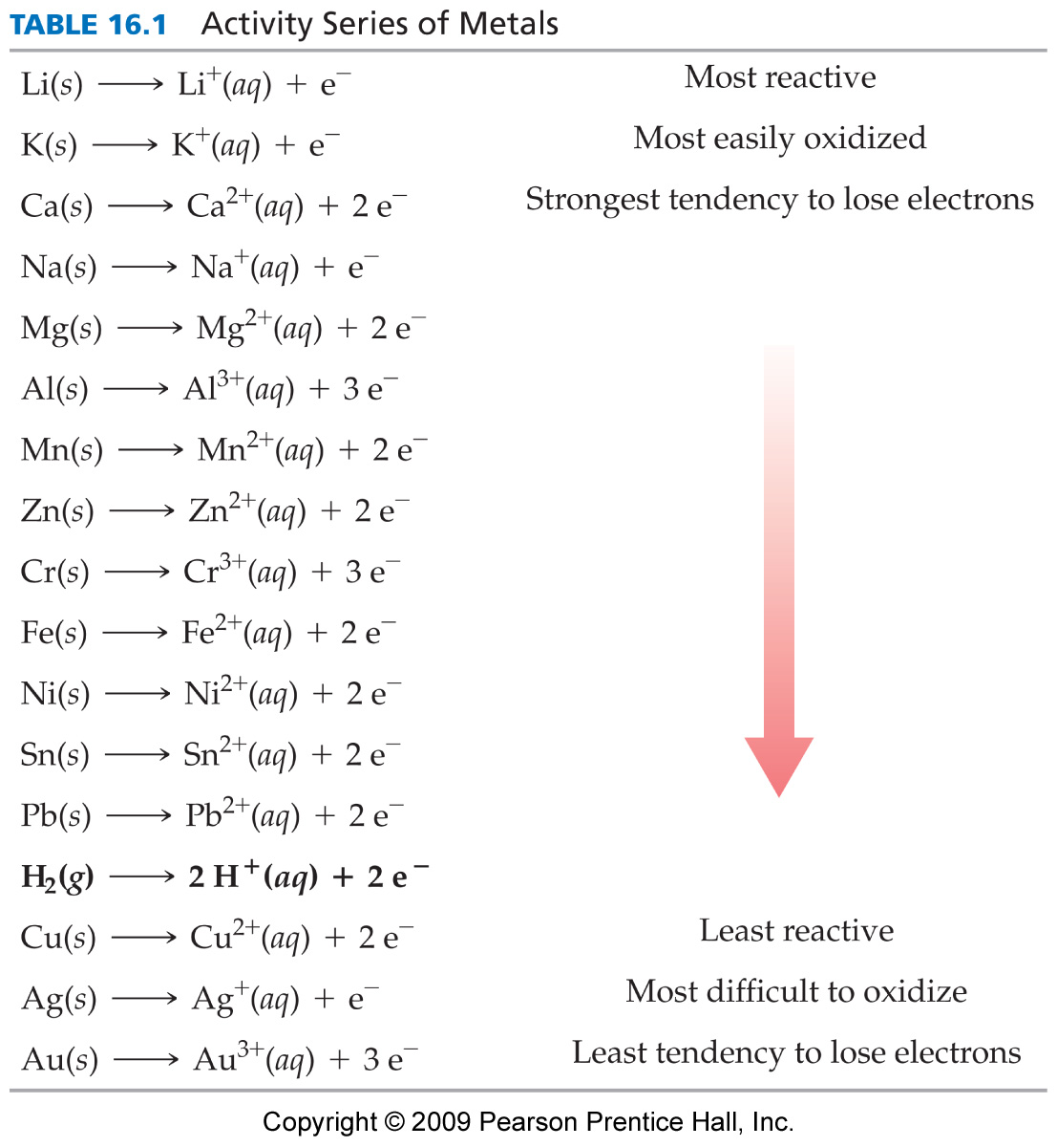
Activity Series (The Tendency to Lose Electrons)
Most
If Metal A has a greater tendency to lose electrons than Metal B, then:
A(s) + B⁺(aq) → A⁺(aq) + B(s)
A⁺(aq) + B(s) → no reaction.
Least

Slide 23
Activity Series of Metals
Cu + H⁺ → no reaction
Mg + 2H⁺ → Mg²⁺ + H₂ (g)
Zn + Fe²⁺ → Fe + Zn²⁺
Cu + Fe²⁺ → no reaction

Slide 24
Predict the Products and Balance the Equation.
Mg + H₃PO₄ →
Cu + H₂SO₄ →
Al + Fe²⁺ →

Slide 25
Predict the Products and Balance the Equation, Continued.
3 Mg + 2 H₃PO₄ → Mg₃(PO₄)₂ + 3 H₂
Cu + H₂SO₄ → No reaction.
2 Al + 3 Fe²⁺ → 2 Al³⁺ + 3 Fe

